Slide 1
Como é que os líderes conseguem comunicar tão bem?
Boost Your Talent
4 de Outubro de 2017
Ann Henshall

Slide 2
Como é que os líderes conseguem comunicar tão bem?
Conselhos para escrever um bom discurso
Uma visão mais técnica/académica
Contrastar exemplos concretos

Slide 3
Conselhos para um bom discurso
Conte uma história.
Personalize o discurso
Termine com um apelo à ação
Seja curto

Slide 4
Figuras de retórica
http://sixminutes.dlugan.com
Citações
Questões retóricas
Trios
Anáfora
Epistrofia
Quiasma
Estruturas paralelas

Slide 5
Quais dessas técnicas são exemplificadas num discurso conhecido de alguém famoso?

Slide 7
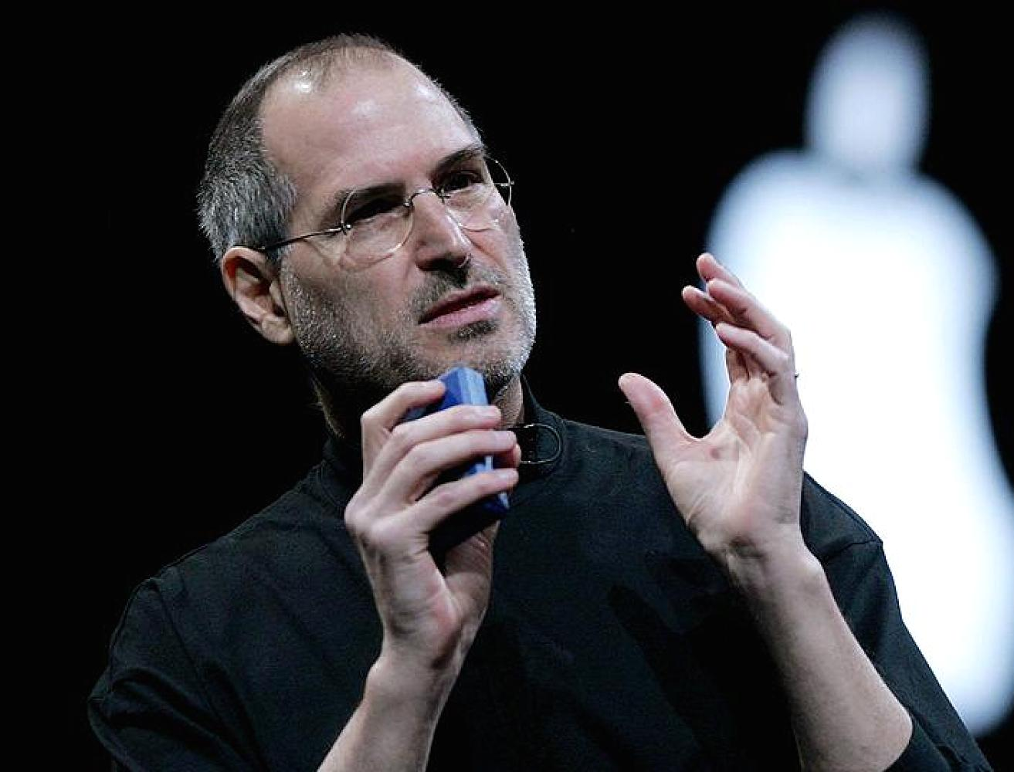
Steve Jobs
“I mean, his whole thing of knowing exactly what he’s going to say, but up on stage saying it in such a way that he is trying to make you think he’s thinking it up right then…”
Bill Gates, falando sobre Steve Jobs.

Slide 8
Steve Jobs
Commencement Address
Universidade de Stanford, EUA
Junho de 2005
http://news.stanford.edu/2005/06/14/jobs-061505/
https://www.youtube.com/watch?v=UF8uR6Z6KLc

Slide 9
Trios
Elabora uma ideia em três partes
Permite
explicar um conceito com mais clareza
reforçar o essencial
aumentar o potencial de os ouvintes memorizarem a ideia
estabelecer ritmo
criar uma sensação de expectativa

Slide 10
Trios
I am honored to be with you today at your commencement from one of the finest universities in the world. I never graduated from college. Truth be told, this is the closest I’ve ever gotten to a college graduation. Today I want to tell you three stories from my life.
That’s it.
No big deal.
Just three stories.
The first story is about connecting the dots.

Slide 11
Trios
I am honored to be with you today at your commencement from one of the finest universities in the world. I never graduated from college. Truth be told, this is the closest I’ve ever gotten to a college graduation. Today I want to tell you three stories from my life.
That’s it.
No big deal.
Just three stories.
The first story is about connecting the dots.

Slide 12
Perguntas retóricas
O orador coloca uma pergunta mas não espera nenhuma resposta dos ouvintes
Permite
pôr os ouvintes a pensar
convidar os ouvintes a partilhar as opiniões do orador
colocar uma pergunta que os ouvintes estão já a pensar para dar logo a resposta

Slide 13
Perguntas retóricas
The first story is about connecting the dots.
I dropped out of Reed College after the first 6 months, but then stayed around as a drop-in for another 18 months or so before I really quit.
So why did I drop out?
It started before I was born….

Slide 14
Trios
Because I had dropped out and didn’t have to take the normal classes, I decided to take a calligraphy class to learn how to do this. I learned
(1) about serif and sans serif typefaces,
(2) about varying the amount of space between different letter combinations,
(3) about what makes great typography great.
It was beautiful, historical, artistically subtle in a way that science can’t capture, and I found it fascinating

Slide 15
Trios
Because I had dropped out and didn’t have to take the normal classes, I decided to take a calligraphy class to learn how to do this. I learned about serif and sans serif typefaces, about varying the amount of space between different letter combinations, about what makes great typography great.
It was
(1) beautiful,
(2) historical,
(3) artistically subtle
in a way that science can’t capture, and I found it fascinating

Slide 16
Estruturas paralelas
Utiliza a mesma estrutura gramatica com léxico diferente
Permite
exprimir a ideia de forma clara
aumentar o potencial de os ouvintes memorizar a ideia
introduzir equilíbrio/ ritmo
exprimir a ideia de forma concisa
sublinhar uma comparação

Slide 17
Estruturas paralelas
Because I had dropped out and didn’t have to take the normal classes, I decided to take a calligraphy class to learn how to do this. I learned
(1) about serif and sans serif typefaces,
(2) about varying the amount of space between different letter combinations,
(3) about what makes great typography great.
It was beautiful, historical, artistically subtle in a way that science can’t capture, and I found it fascinating
São todas frases preposicionais

Slide 18
Estruturas paralelas
Because I had dropped out and didn’t have to take the normal classes, I decided to take a calligraphy class to learn how to do this. I learned about serif and sans serif typefaces, about varying the amount of space between different letter combinations, about what makes great typography great.
It was
(1) beautiful,
(2) historical,
(3) artistically subtle
in a way that science can’t capture, and I found it fascinating
São todos adjetivos

Slide 19
Estruturas paralelas
I didn’t see it then, but it turned out that getting fired from Apple was the best thing that could have ever happened to me.
The heaviness of being successful was replaced by
the lightness of being a beginner again, less sure about everything.
It freed me to enter one of the most creative periods of my life.

Slide 20
Eipistofia
Repetição intencional de um elemento ao fim da frase
Permite
salientar a ideia, utilizando o foco da fim da frase

Slide 21
Epistofia
How can you get fired from a company you started? Well, as Apple grew we hired someone who I thought was very talented to run the company with me, and for the first year or so things went well. But then our visions of the future began to diverge and eventually we had a falling out. When we did, our Board of Directors sided with him.
So at 30 I was out.
And very publicly out.
What had been the focus of my entire adult life was gone, and it was devastating.

Slide 22
Anáfora
Repetição intencional de uma expressão no início da frase
Permite
aumentar a carga emocional
reforçar uma ideia central

Slide 23
Anáfora
No one wants to die. Even people who want to go to heaven don’t want to die to get there. And yet death is the destination we all share.
No one has ever escaped it. And that is as it should be, because Death is very likely the single best invention of Life. It is Life’s change agent. It clears out the old to make way for the new.

Slide 24
Anáfora
Our time is limited,
so don’t waste it living someone else’s life.
Don’t be trapped by dogma — which is living with the results of other people’s thinking.
Don’t let the noise of others’ opinions drown out your own inner voice. And most important, have the courage to follow your heart and intuition. They somehow already know what you truly want to become. Everything else is secondary.

Slide 25
Citações
Utiliza as palavras escritas por outra pessoa
Permite
condensar/reforçar as suas ideias com uma citação facilmente memorável
aumentar a sua credibilidade através da demonstração de conhecimentos sobre o fenómeno
criar antecipação nos ouvintes

Slide 26
Apelo à ação
Pede aos ouvintes de fazer alguma coisa
Permite
sensibilizar os ouvintes a um objetivo do discurso

Slide 27
Citações
Stewart and his team put out several issues of The Whole Earth Catalog, and then when it had run its course, they put out a final issue. It was the mid-1970s, and I was your age. On the back cover of their final issue was a photograph of an early morning country road, the kind you might find yourself hitchhiking on if you were so adventurous. Beneath it were the words: “Stay Hungry. Stay Foolish.” It was their farewell message as they signed off. Stay Hungry. Stay Foolish. And I have always wished that for myself. And now, as you graduate to begin anew, I wish that for you.
Stay Hungry. Stay Foolish.
Thank you all very much.

Slide 28
Balanço das técnicas exemplificadas no “Commencement Address” de Steve Jobs

Slide 29
Steve Jobs: Commencement Address
“Tell a story” / Contar uma história
Personalizar
Ser curto
Terminar com um apelo
Citações
Questões retóricas
Trios
Anáfora
Epistrofia
Quiasma
Estruturas paralelas
= comunicação eficaz?

Slide 30
Comunicar bem implica
Conhecimento do contexto social do ato da comunicação
Onde tem lugar?
Quem é o orador?
Quem é o público?
Qual é o propósito do discurso?
conteúdo do texto
estrutura do texto
linguagem apropriada
Se o texto conseguir concretizar plenamente o propósito, então comunicou bem.

Slide 31
Contexto do discurso
Onde tem lugar?
Quem é o orador?
Quem é o público?
Qual é o propósito do discurso?
Na cerimónia de finalistas da Universidade de Stanford
Steve Jobs, empreendedor, fundador de Apple, Pixar
Alunos universitários que estão na cerimónia da graduação
Marcar esse momento de transição do mundo do estudo para o mundo do trabalho
Dar conselhos inspiradores
conteúdo estrutura linguagem
do discurso do discurso apropriada

Slide 32
Organização hierárquica
Abertura (situa o discurso no contexto)
I am honored to be with you today at your commencement from one of the finest universities in the world. …
Introdução
Previsão de estrutura
Today I want to tell you three stories from my life. …
Episódio
My first story is about connecting the dots.
Episódio
My second story is about love and loss.
Corpo
Episódio
My third story is about death.
Fecho

Slide 33
Organização hierárquica
Episódio
Historia 1
My first story is about connecting the dots.
Lição 1
You have to trust in something — your gut, destiny, life, karma, whatever.
Episódio
Historia 2
My second story is about love and loss.
Corpo
Lição 2
Don’t lose faith. … Don’t settle.
Episódio
Historia 3
My third story is about death.
Lição 3
Your time is limited, so don’t waste it living someone else’s life.

Slide 34
Organização hierárquica
Abertura
Introdução
Previsão de estrutura
Episódio
Historia 1
Lição 1
Episódio
Historia 2
Corpo
Lição 2
Episódio
Historia 3
Lição 3
Fecho

Slide 35
Que tipo de história contar?
fábula
conto de fada
anedota
lenda
Propósitos diferentes
Estruturas diferentes
Conteúdos diferentes
Linguagem diferente

Slide 36
Pequenas histórias quotidianas têm propósitos diferentes
Propósito
Partilhar uma emoção
Fiquei mesmo chateada.
Fazer um juízo de valor sobre uma pessoa
Ele merece ficar preso durante 20 anos.
Comentar/avaliar uma situação
Foi a melhor coisa que me podia ter acontecido.
Estrutura (etapas) Conteúdo Linguagem

Slide 37
História para comentar
História 1
Orientação
apresenta o contexto
Registo de eventos
conta o que aconteceu, descreve sentimentos
Comentário
revê e avalia aquilo que se passou através dos olhos adultos
Estabelece um comparação entre o jovem inexperiente e o adulto mais sábio
Cria empatia com os ouvintes através da descrição de emoções e sentimentos (e.g. felicidade) e julgamentos sobre o falador próprio (e.g. insegurança, fracassos)

Slide 38
Estrutura do 1º episódio
História 1
My first story is about connecting the dots.
Orientação
I dropped out of Reed College after the first 6 months, but then stayed around as a drop-in for another 18 months or so before I really quit. So why did I drop out?
Registo de eventos
It started before I was born. …
And 17 years later I did go to college. But …
Comentário
And much of what I stumbled into by following my curiosity and intuition turned out to be priceless later on.
Exemplo
História
orientação
registo de eventos
comentário
Lição 1
Again, you can’t connect the dots looking forward; you can only connect them looking backward. So you have to trust that the dots will somehow connect in your future. You have to trust in something — your gut, destiny, life, karma, whatever. This approach has never let me down, and it has made all the difference in my life.

Slide 39
Linguagem avaliativa
Uso estratégico da linguagem avaliativa na história ajuda criar empatia e solidariedade com os finalistas

Slide 40
Linguagem avaliativa
História 1
My first story is about connecting the dots.
Registo
de eventos
And 17 years later I did go to college. But I naively chose a college that was almost as expensive as Stanford, and all of my working-class parents’ savings were being spent on my college tuition. After six months, I couldn’t see the value in it. I had no idea what I wanted to do with my life and no idea how college was going to help me figure it out. And here I was spending all of the money my parents had saved their entire life. So I decided to drop out and trust that it would all work out OK. It was pretty scary at the time, but looking back it was one of the best decisions I ever made. The minute I dropped out I could stop taking the required classes that didn’t interest me, and begin dropping in on the ones that looked interesting.
Juízes de valor o jovem Steve Jobs
ingénuo, incapaz

Slide 41
Linguagem avaliativa
História 1
My first story is about connecting the dots.
Registo
de eventos
And 17 years later I did go to college. But I naively chose a college that was almost as expensive as Stanford, and all of my working-class parents’ savings were being spent on my college tuition. After six months, I couldn’t see the value in it. I had no idea what I wanted to do with my life and no idea how college was going to help me figure it out. And here I was spending all of the money my parents had saved their entire life. So I decided to drop out and trust that it would all work out OK. It was pretty scary at the time, but looking back it was one of the best decisions I ever made. The minute I dropped out I could stop taking the required classes that didn’t interest me, and begin dropping in on the ones that looked interesting.
Avaliações de situações ou de coisas
Desistir = assustador disciplinas obrigatórias = sem interesse
decisão de desistir = melhor decisão outras disciplinas = interessantes

Slide 42
Linguagem avaliativa
História 1
My first story is about connecting the dots.
Registo
de eventos
And 17 years later I did go to college. But I naively chose a college that was almost as expensive as Stanford, and all of my working-class parents’ savings were being spent on my college tuition. After six months, I couldn’t see the value in it. I had no idea what I wanted to do with my life and no idea how college was going to help me figure it out. And here I was spending all of the money my parents had saved their entire life. So I decided to drop out and trust that it would all work out OK. It was pretty scary at the time, but looking back it was one of the best decisions I ever made. The minute I dropped out I could stop taking the required classes that didn’t interest me, and begin dropping in on the ones that looked interesting.
Valores negativos
Valores positivos

Slide 43
Lição: propósito e linguagem
Lição
Dar conselhos
Lição 1
Again, you can’t connect the dots looking forward; you can only connect them looking backward. So you have to trust that the dots will somehow connect in your future. You have to trust in something — your gut, destiny, life, karma, whatever.
Emprega 2ª pessoa para falar directamente aos finalistas

Slide 44
Linguagem avaliativa
História 2
My second story is about love and loss.
Registo
de eventos
I really didn’t know what to do for a few months. I felt that I had let the previous generation of entrepreneurs down — that I had dropped the baton as it was being passed to me. I met with David Packard and Bob Noyce and tried to apologize for screwing up so badly. I was a very public failure, and I even thought about running away from the valley. But something slowly began to dawn on me — I still loved what I did. The turn of events at Apple had not changed that one bit. I had been rejected, but I was still in love. And so I decided to start over.
I didn’t see it then, but it turned out that getting fired from Apple was the best thing that could have ever happened to me. The heaviness of being successful was replaced by the lightness of being a beginner again, less sure about everything. It freed me to enter one of the most creative periods of my life.
Comentário
Juízes de valor: Steve Jobs = incapaz

Slide 45
Linguagem avaliativa
História 2
My second story is about love and loss.
Indica mudança de juízes de valor negativos para os positivos
Registo
de eventos
I really didn’t know what to do for a few months. I felt that I had let the previous generation of entrepreneurs down — that I had dropped the baton as it was being passed to me. I met with David Packard and Bob Noyce and tried to apologize for screwing up so badly. I was a very public failure, and I even thought about running away from the valley. But something slowly began to dawn on me — I still loved what I did. The turn of events at Apple had not changed that one bit. I had been rejected, but I was still in love. And so I decided to start over.
I didn’t see it then, but it turned out that getting fired from Apple was the best thing that could have ever happened to me. The heaviness of being successful was replaced by the lightness of being a beginner again, less sure about everything. It freed me to enter one of the most creative periods of my life.
Comentário
Juízes de valor: Steve Jobs = incapaz
= perspicaz

Slide 46
Linguagem avaliativa
História 2
My second story is about love and loss.
Registo
de eventos
I really didn’t know what to do for a few months. I felt that I had let the previous generation of entrepreneurs down — that I had dropped the baton as it was being passed to me. I met with David Packard and Bob Noyce and tried to apologize for screwing up so badly. I was a very public failure, and I even thought about running away from the valley. But something slowly began to dawn on me — I still loved what I did. The turn of events at Apple had not changed that one bit. I had been rejected, but I was still in love. And so I decided to start over.
I didn’t see it then, but it turned out that getting fired from Apple was the best thing that could have ever happened to me. The heaviness of being successful was replaced by the lightness of being a beginner again, less sure about everything. It freed me to enter one of the most creative periods of my life.
Comentário
Emoções sentidos - positivas

Slide 47
Linguagem avaliativa
História 2
My second story is about love and loss.
Registo
de eventos
I really didn’t know what to do for a few months. I felt that I had let the previous generation of entrepreneurs down — that I had dropped the baton as it was being passed to me. I met with David Packard and Bob Noyce and tried to apologize for screwing up so badly. I was a very public failure, and I even thought about running away from the valley. But something slowly began to dawn on me — I still loved what I did. The turn of events at Apple had not changed that one bit. I had been rejected, but I was still in love. And so I decided to start over.
I didn’t see it then, but it turned out that getting fired from Apple was the best thing that could have ever happened to me. The heaviness of being successful was replaced by the lightness of being a beginner again, less sure about everything. It freed me to enter one of the most creative periods of my life.
Comentário
Situações ou coisas avaliadas de forma positiva
Ser despedido de Apple = melhor coisa
período depois de Apple = muito criativo

Slide 48
As 3 histórias
São histórias de triunfo sobre adversidade
São bem estruturadas
Criam empatia e solidariedade com o público através de linguagem avaliativa
Servem como base para as lições

Slide 49
Lições: linguagem apropriada para fins do discurso
Lição 2
Your time is limited, so don’t waste it living someone else’s life. Don’t be trapped by dogma — which is living with the results of other people’s thinking. Don’t let the noise of others’ opinions drown out your own inner voice. And most important, have the courage to follow your heart and intuition. They somehow already know what you truly want to become.
Lição 3
… You’ve got to find what you love. And that is as true for your work as it is for your lovers. Your work is going to fill a large part of your life, and the only way to be truly satisfied is to do what you believe is great work. …
Lição no fecho
Stay hungry. Stay foolish.
2ª pessoa imperativo

Slide 50
Estrutura do fecho
História
When I was young, there was an amazing publication called The Whole Earth Catalog, which was one of the bibles of my generation. ...
Orientação
Registo de eventos
Stewart and his team put out several issues of The Whole Earth Catalog, and then when it had run its course, they put out a final issue. …
Fecho
Comentário
Stay Hungry. Stay Foolish. And I have always wished that for myself.
Lição
And now, as you graduate to begin anew, I wish that for you. Stay hungry. Stay Foolish.
Fecho
Thank you.

Slide 51
Conteúdo do fecho
História
Orientação
When I was young, there was an amazing publication called The Whole Earth Catalog, which was one of the bibles of my generation. It was created by a fellow named Stewart Brand not far from here in Menlo Park, and he brought it to life with his poetic touch. This was in the late 1960s, before personal computers and desktop publishing, so it was all made with typewriters, scissors and Polaroid cameras. It was sort of like Google in paperback form, 35 years before Google came along: It was idealistic, and overflowing with neat tools and great notions
Fecho
Constrói uma ideia nova/estranha
com informação que o público conhece

Slide 52
Conteúdo do fecho
História
Stewart and his team put out several issues of The Whole Earth Catalog, and then when it had run its course, they put out a final issue. It was the mid-1970s, and I was your age. On the back cover of their final issue was a photograph of an early morning country road, the kind you might find yourself hitchhiking on if you were so adventurous. Beneath it were the words: “Stay Hungry. Stay Foolish.” It was their farewell message as they signed off. Stay Hungry. Stay Foolish.
And I have always wished that for myself.
And now, as you graduate to begin anew, I wish that for you. Stay hungry. Stay foolish.
Registo de eventos
Fecho
Comentário
Lição
Paralelos entre o a vida da revista, o orador Steve Jobs e os ouvintes
Imagens de juventude, fins de etapas e de inícios

Slide 53
Conteúdo do fecho
História
Stewart and his team put out several issues of The Whole Earth Catalog, and then when it had run its course, they put out a final issue. It was the mid-1970s, and I was your age. On the back cover of their final issue was a photograph of an early morning country road, the kind you might find yourself hitchhiking on if you were so adventurous. Beneath it were the words: “Stay Hungry. Stay Foolish.” It was their farewell message as they signed off. Stay Hungry. Stay Foolish.
And I have always wished that for myself.
And now, as you graduate to begin anew, I wish that for you. Stay hungry. Stay foolish.
Registo de eventos
Fecho
Comentário
Lição
Paralelos entre o a vida da revista, o orador Steve Jobs e os ouvintes
Imagens de juventude, fins de etapa e de inícios

Slide 54
Conteúdo do fecho
História
Registo de eventos
Stewart and his team put out several issues of The Whole Earth Catalog, and then when it had run its course, they put out a final issue. It was the mid-1970s, and I was your age. On the back cover of their final issue was a photograph of an early morning country road, the kind you might find yourself hitchhiking on if you were so adventurous. Beneath it were the words: “Stay Hungry. Stay Foolish.” It was their farewell message as they signed off. Stay Hungry. Stay Foolish.
And I have always wished that for myself.
And now, as you graduate to begin anew, I wish that for you. Stay hungry. Stay foolish.
Fecho
Comentário
Lição
Paralelos entre o a vida da revista, o orador Steve Jobs e os ouvintes
Imagens de juventude, fins de etapas e de inícios

Slide 55
Conteúdo do fecho
Paralelos entre o a vida da revista, o orador Steve Jobs e os ouvintes
Imagens de juventude, fins de etapas e de inícios
Propósito de marcar o momento de transição

Slide 56
Steve Jobs comunicou bem porque
conteúdo do discurso
estrutura do discurso
linguagem
soube adequar
às restrições do contexto
CONTEXTO SOCIAL | onde | Na cerimónia de finalistas da Universidade de Stanford
 | orador | Steve Jobs, empreendedor, fundador de Apple, Pixar
 | público | Alunos finalistas universitários
 | propósito do discurso | Marcar o momento de transição do mundo do estudo para o mundo do trabalho Dar conselhos inspiradores

Slide 57
Que papeis tiveram as figuras retóricas?
estruturar etapas do discurso
realçar/salientar ideias, ações, emoções
tornar uma imagem mais memorável
condensar uma ideia chave
Porquê desisti?
I was out. Very publicly out.
The heaviness of being successful was replaced by the lightness of being a beginner again

Slide 58
Como comunicar bem
Figuras retóricas
Conteúdo
Estrutura
Linguagem
Compreensão do contexto socio-cultural

Slide 59
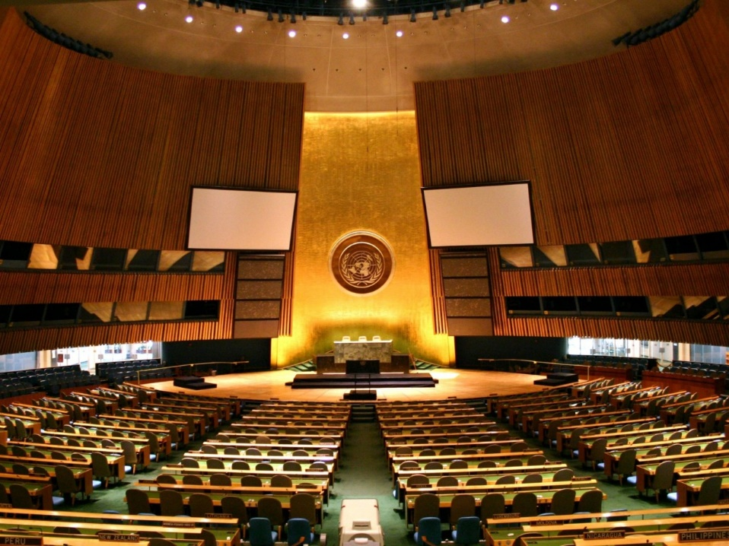

Slide 60
Contexto do discurso
Onde tem lugar?
Quem é o orador?
Quem é o público?
Qual é o propósito do discurso?
Na Assembleia Geral das Nações Unidas, depois da NU ter levantado as sanções contra África do Sul, depois de tirar o assunto de apartheid da agenda, e depois das eleições democráticas no país.
Nelson Mandela, presidente de África do Sul
Outros presidentes/delegados de países membros das Nações Unidas
Marcar o momento
Confirmar o direito de África de Sul ser presente como membro igual aos outros países
conteúdo estrutura linguagem
do discurso do discurso apropriada

Slide 61
Nelson Mandela: Discurso às Nações Unidas
It surely must be one of the great ironies of our age that this August Assembly is addressed, for the first time in its 49 years, by a South African head of state drawn from among the African majority of what is an African country.
Future generations will find it strange in the extreme that it was only so late in the 20th century that it was possible for our delegation to take its seat in the Assembly, recognized both by our people and the nations of the world as the legitimate representative of the people of our country.
It is indeed a most welcome thing that this August Organization will mark its 50th anniversary next year with the apartheid system having been vanquished and consigned to the past.
http://www.unric.org/en/images/stories/in-focus/Mandela_landmark_speech_to_the_UN.pdf

Slide 62
Estrutura/Etapas
Abertura
(situa o discurso no contexto)
It surely must be one of the great ironies of our age that this August Assembly is addressed, for the first time in its 49 years, by a South African head of state drawn from among the African majority of what is an African country.
Future generations will find it strange in the extreme that it was only so late in the 20th century that it was possible for our delegation to take its seat in the Assembly, recognized both by our people and the nations of the world as the legitimate representative of the people of our country.
It is indeed a most welcome thing that this August Organization will mark its 50th anniversary next year with the apartheid system having been vanquished and consigned to the past.
Comentário
Introdução

Slide 63
Linguagem: entidades e processos institucionais
It surely must be one of the great ironies of our age that this August Assembly is addressed, for the first time in its 49 years, by a South African head of state drawn from among the African majority of what is an African country.
Future generations will find it strange in the extreme that it was only so late in the 20th century that it was possible for our delegation to take its seat in the Assembly, recognized both by our people and the nations of the world as the legitimate representative of the people of our country.
It is indeed a most welcome thing that this August Organization will mark its 50th anniversary next year with the apartheid system having been vanquished and consigned to the past.

Slide 64
Conteúdo e linguagem: entidades e processos institucionais
It surely must be one of the great ironies of our age that this August Assembly is addressed, for the first time in its 49 years, by a South African head of state drawn from among the African majority of what is an African country.
Future generations will find it strange in the extreme that it was only so late in the 20th century that it was possible for our delegation to take its seat in the Assembly, recognized both by our people and the nations of the world as the legitimate representative of the people of our country.
It is indeed a most welcome thing that this August Organization will mark its 50th anniversary next year with the apartheid system having been vanquished and consigned to the past.

Slide 65
Linguagem formal
Surely it’s ironic
It surely must be one of the great ironies of our age that this August Assembly is addressed, for the first time in its 49 years, by a South African head of state drawn from among the African majority of what is an African country.
Future generations will find it strange in the extreme that it was only so late in the 20th century that it was possible for our delegation to take its seat in the Assembly, recognized both by our people and the nations of the world as the legitimate representative of the people of our country.
It is indeed a most welcome thing that this August Organization will mark its 50th anniversary next year with the apartheid system having been vanquished and consigned to the past.
really strange
It’s good
overcome and got rid of

